Slide 1
Category review: Chips
June 2020
Retail Analytics
Brand note: If client logo is not required, use alternate title page layout right click slide thumbnail > Layout > Title

Slide 2
Notes:
To view Privacy video explaining how important data privacy is to Quantium, please click here: https://www.youtube.com/watch?v=Zq1QDAkoRzU
or here Q:\Company Reference\Brand & Design\Brand videos\Q Privacy.mp4
At Quantium, we believe that data is the behavioural footprint of humanity and that it has to be treated with the utmost care and responsibility.
Histories, attitudes, indeed lives are stored within it in ways that aren’t always apparent – and that’s what makes its potential so powerful.
To work with it responsibly, sensitively, we set ourselves the highest data privacy protection and governance standards.
We have spent 17 years perfecting privacy-by-design and secure-by-design principles. Central to this is not holding any personally identifiable information about people –
we neither receive it, and put the necessary protections in place to be unable to decipher it.
Every aspect of handling data is safeguarded: from its de-identification, to its encryption – data security is paramount and of the highest grade.
We pride ourselves on gaining the trust of iconic organisations around the world through years of securely working with their data,
and in turn the trust that builds with their stakeholders.

Slide 3
Executive summary
01
Task 1
Analysis of customer purchasing behaviors revealed key insights: sales peak around the holiday season, especially from December 21st to 24th, aligning with increased demand. Affluent customer segments, such as young families and retirees, show higher spending, suggesting these groups as primary targets for future promotions. Additionally, larger pack sizes and popular brands drive sales, highlighting an opportunity for focused product placement and seasonal promotions to optimize revenue.
02
Task 2
The trial store layout changes demonstrated promising results, with trial stores showing increased total sales and consistent customer engagement compared to control stores. Analysis indicates that the new layout positively influenced customer behavior, with higher average transactions per customer and greater footfall stability. Based on these findings, rolling out the new layout across similar locations is recommended to capitalize on this uplift in performance.

Slide 4
01
Category

Slide 5
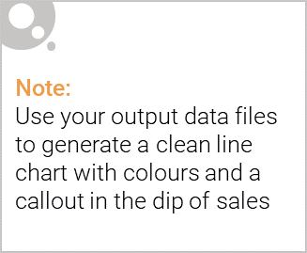
Overview:
The chips category shows a consistent pattern of high demand, particularly during holiday periods, driven largely by affluent families and retirees, who represent high-value segments. These groups not only purchase more frequently but also favor larger pack sizes and premium brands, underscoring the potential for targeted promotions. Seasonal campaigns focused on these demographics, especially during peak times, could significantly boost category performance, while strategic product placement for popular pack sizes could enhance engagement across all customer segments.

Slide 6

Affluence and its Effect :
Analysis reveals that affluence significantly impacts purchasing behaviors within the chips category. Higher-income customers, particularly affluent families and retirees, are more inclined to purchase premium brands and larger pack sizes, driving higher sales volumes. These segments display brand loyalty and value quality over price sensitivity, suggesting that upscale or specialty offerings may resonate well. Targeted promotions and premium product placements can effectively capture this demographic's attention. By aligning marketing strategies with these insights, retailers can maximize engagement from affluent customers, enhancing both frequency of purchases and average transaction value within this key category.

Slide 7
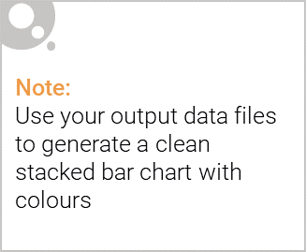
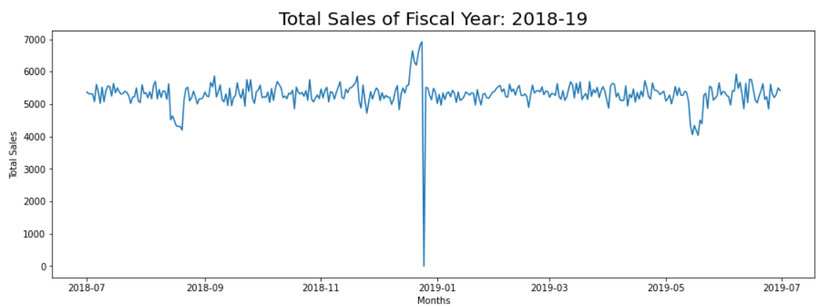
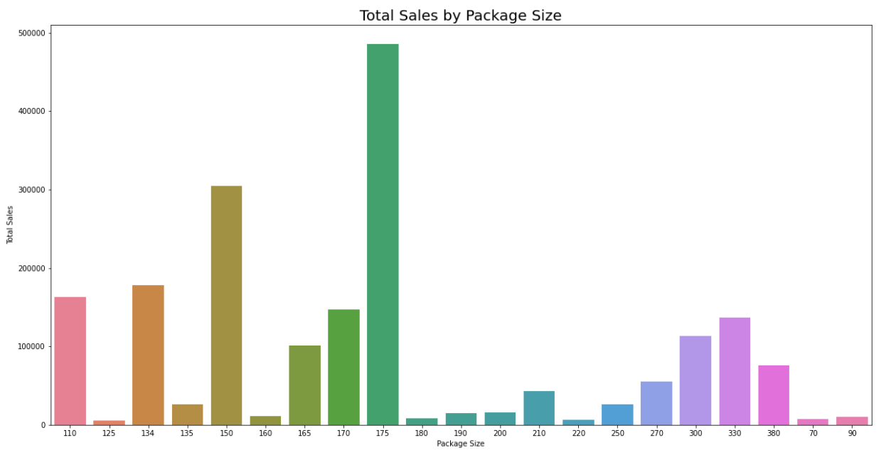
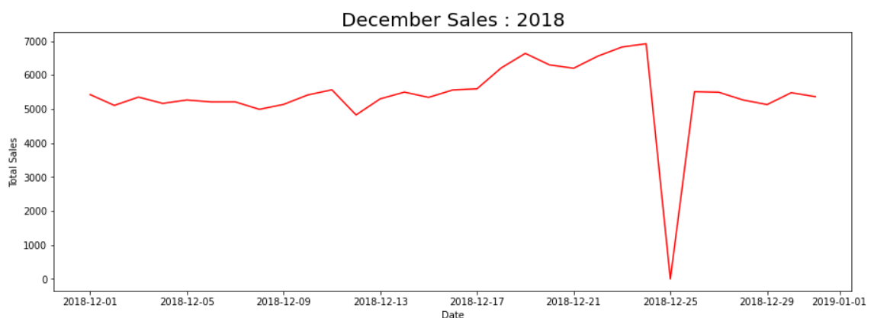
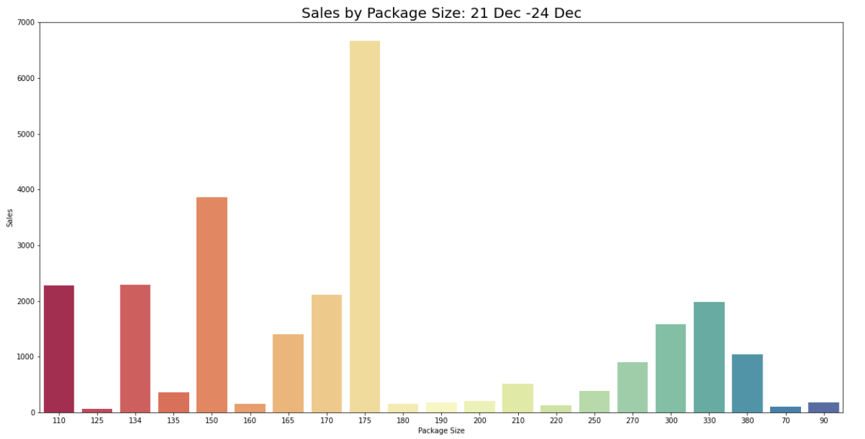
Editable (delete this)

Slide 8
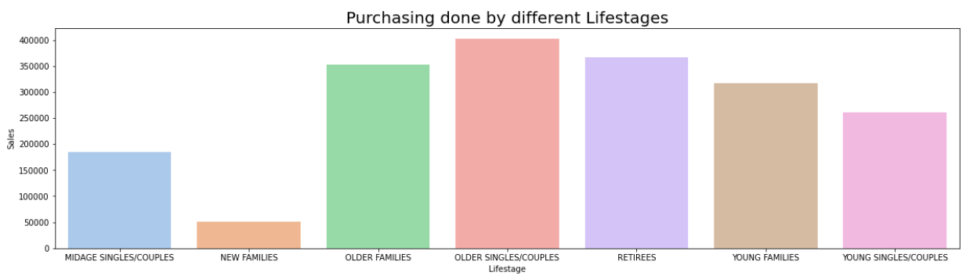
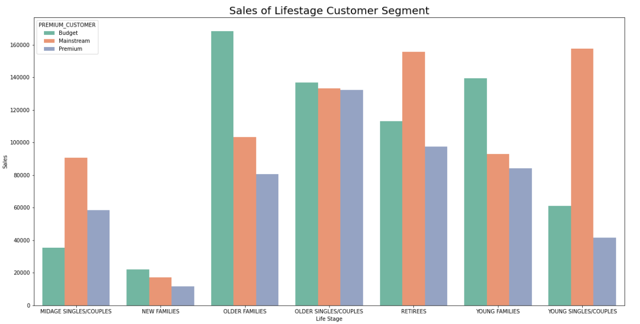

Slide 9
02
Trial Store Performance

Slide 10
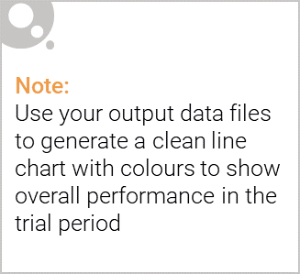
Control store vs Other stores:
In this analysis, control stores were selected to benchmark the impact of the new store layout tested in trial stores. Control stores were chosen based on similar sales patterns and customer demographics to ensure a reliable comparison. By evaluating metrics such as total sales, customer counts, and transactions per customer, we measured the performance uplift in trial stores compared to controls. This comparison allows us to isolate the effects of the new layout, ensuring that any observed differences in trial stores are likely due to the layout change rather than other external factors.

Slide 11
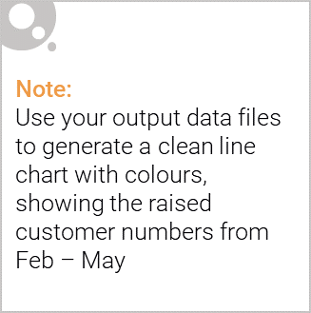
Trial Stores, Successful?
Total Sales Revenue: The trial stores outperformed their control stores in total sales during the trial period. This increase was linked to a higher number of customers and more transactions per customer.
Customer Footfall: All trial stores attracted more customers than their respective control stores, demonstrating increased engagement with the new layout.
Transactions per Customer: The trial stores maintained a higher average of transactions per customer compared to control stores.
Conclusion: The success in attracting more customers and boosting sales suggests that implementing the new layout across all stores could enhance customer experience and increase sales potential. Thus, the trial can be considered successful, and the new layout is recommended for broader implementation​

Slide 12
